Slide 1
Focusing on Assignments and Student Work in Mathematics Advanced Unit 2 Produced Under U.S. Department of Education Contract No. ED-VAE-13-C-0066, With StandardsWork, Inc. 2016

Slide 2
Why is it Important to Review Assignments?
“Students can do no better than the assignments they are given.”
−Kati Haycock, The Education Trust
Notes:
Big Idea: Provide an inspirational starting place for this work by reading the quote from The Education Trust’s, Kati Haycock.
Facilitator Talking Points:
Using actual classroom assignments and student work created in response to those assignments is instrumental to our work.
Nothing more accurately confirms what happens in the classroom than instructor assignments and the student work produced in response to those assignments. Together they verify what students are being taught and what they have learned.
For the purposes of these discussions we need to make sure we have a common understanding of what constitutes an “assignment” as opposed to a lesson. (Click through the slide and ask for questions before continuing.)
An assignment is what students produce as the result of a lesson, and may, or may not, come with accompanying scoring guidelines, answer keys, targeted standards identified, or other teacher support information.
An assignment is not a lesson with full teacher instructions, scripts, examples, questions, investigations, etc., intended to be experienced by the student in a full class period, over several class periods, or other segment of time.
Facilitator Note:
Using student work to guide CCR implementation and sustainability evaluates the work at the critical level of the learner.

Slide 3
Purpose
Connect teacher assignments and student work to standards.
Develop high expectations that are well-aligned with the level-specific CCR standards.
Improve instructional practices and strategies.
Engage in structured, thoughtful conversations about standards-based instruction with colleagues.
Notes:
Big Idea: Introduce the purpose of the student work protocol.
Facilitator Talking Point:
Our work in this session will focus on important connections between classroom assignments, student work in response to those assignments, and the expectations defined in the CCR standards.
Facilitator Notes:
Because student assignments and work is excellent evidence of CCR standards alignment, using a student work protocol supports educators as they work together to better align teacher and learning to the CCRS.
This work also lays the foundation for structured, thoughtful and collegial conversations about instruction aligned to the CCR standards.

Slide 4
Feedback Checklist for Team Members
I will… I did…
Provide feedback on the strengths and accomplishments of the assignment, as well as on its weaknesses and on areas where it can be strengthened.
Give feedback in a manner I would like to receive it.
Focus on the assignment, rather than on judgments about my colleague as a person or a professional.
Demonstrate support for my colleague when providing feedback by using nonjudgmental language and a supportive tone of voice and body language.
Avoid overwhelming my colleague with more feedback than is needed. Encourage my colleague to let me know when it is difficult to hear my feedback.
Be as specific as possible, suggesting instructional approaches, resources, etc., to improve the assignment.
Leave my colleague feeling helped, motivated, and inspired.
Notes:
Big Idea: Introduce the Feedback Checklist for Team Members.
Facilitator Talking Point:
The materials provided also includes a similar checklist for the presenting instructor. However since we will all be acting as “team members” in this training, we will not use that form yet.
Facilitator Notes:
Have participants locate the Feedback Checklist for Presenting Instructor in their materials and briefly read through it.
Use this slide to prepare participants, who will act as team members, for the kind and quality of feedback they will need to provide. Spend some time reviewing and reflecting on what constitutes effective, respectful feedback for fruitful discussions. Start by reviewing the feedback checklist. Make sure the team thinks the checklist adequately reflects their desired group norms, refining it as necessary.
For at least the first few times through this process, a facilitator will want to ask each team member—including the presenting instructor—to fill out the feedback checklist before and after the sessions. This will firmly establish the ground rules with team members and serve as a reminder to self-assess the quality of their feedback. As the team gains experience, you may want to use the checklist only intermittently, as a refresher.

Slide 5
Four-Step Student Work Protocol
Step 1: Analyze the purpose and demands of the assignment.
Step 2: Select the CCR standards that best match the assignment’s demands.
Step 3: Analyze student work.
Step 4: Redesign and strengthen the assignment and instructional approaches.
Notes:
Big Idea: Introduce the steps of the process for engaging in the student work protocol.
Facilitator Notes:
Use the slide to read the four steps in the process we will be using to evaluate the quality of an assignment based on student work.
Pause to ask for clarifying questions on the student work protocol, Critical Friends Model, or participant feedback checklist.
Participants will now engage in the protocol process, so that they might learn by doing.

Slide 6
Reminders
There are challenges and rewards in giving and receiving feedback on assignments.
No matter how good an assignment is, it can always be improved.
The process focuses on strengthening assignments–not on evaluating students or judging the presenting instructor.
It should be obvious from reading and analyzing the assignment which standards are being taught and learned.
Notes:
Big Idea: The giving and receiving of feedback is an essential part of the student work protocol, and is designed to provide a focus on improving the CCR-alignment of any submitted assignment and accompanying lesson.
Facilitator Notes:
Use the bullets on this slide to help prepare participants for this process and the work of the session.
It is important that participants in the student work protocol are ready to give and receive feedback on all submitted materials. Doing both of these things well will help improve the assignments developed for adult learners.
The focus of the group should be on identifying and improving the alignment of submitted materials to CCR standards. The assignment is the center of the work, not the students or instructor.

Slide 7
Step 1: Analyze the Purpose and Demands of the Assignment
Use only the directions, prompts, and scoring guides provided to analyze the assignment’s requirements.
Take the assignment at face value.
Study the assignment thoroughly, making notes and observations about the purpose and demands of the assignment.
Notes:
Big Idea: Determine what the assignment materials require of the students.
Facilitator Talking Points:
Start with looking ONLY at the assignment with its prompts and directions, including scoring guidelines and rubrics if supplied to the students. (No other supporting materials should be out yet.)
It is important to look at the assignment through the eyes of students.
No assumptions, presuppositions, or other inferences should be made from the materials – what is required of the students is only possible from what is evidenced by the assignment materials.
Make notes on any observations in the space provided under ‘Step 1’ of the protocol.

Slide 8
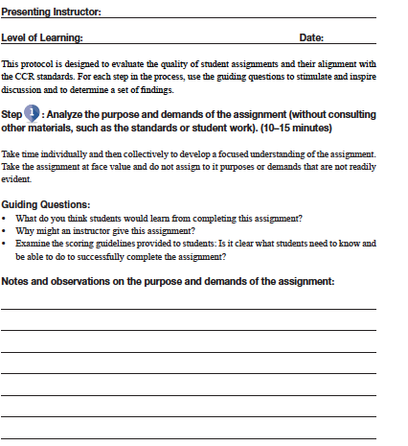
CCR SIA Student Work Protocol for Mathematics
Identifying information
Step description
Questions to guide your discussion
Space for notes and observations
Notes:
Big Idea: Introduce the Student Work Protocol.
Facilitator Note:
Have participants get out their copy of the CCR Student Work Protocol and use this slide to point out the features of the document. This screenshot shows just Step 1 but each step has similar features.

Slide 9
Reminders for Step 1
Do not consult student work samples or other supporting materials (lesson plans, teacher goals, answer keys) at this step.
Ask that the presenting teacher not volunteer what was taught and why, the goals of the lessons, how students did, etc.
The presenting instructor should allow colleagues to determine the the assignment purpose(s).
10-15 minutes
Notes:
Big Idea: Provide tips and reminders for participants as they determine the purpose and demands of the assignment.
Facilitator Talking Points:
It is important to stay focused on the materials students were given (directions and scoring rubrics) – they are the most direct indication of what is being asked of them.
At your tables, discuss the assignment’s components and what learning might take place as result.
Be sure to take notes in the space provided on protocol handout in box under ‘Step 1’.
Facilitator Notes:
To better inform clarity of instructions and potential student learning, participants should actually work through the task and make notes about strategies the students might use and what they might learn from doing the work. This includes reading through any passages that are part of the assignment.
While it may be difficult, remind participants that the presenting teacher should remain quiet during this time, not offering any context, background, or inferences.
Participants should now spend 10-15 minutes engaging in Step 1.
Ask a couple of participants to share their ideas with the whole group.

Slide 10
Step 2: Select the CCR Standards that Best Match the Assignment’s Demands
Select CCR standard(s) that align to the assignment.
Check the skills and knowledge identified in the standards against those identified in the assignment in Step 1.
Determine how rigorously aligned the assignment is to those standards.
Make notes and observations.
If the assignment is clearly not meeting any level-specific CCR standards— skip to Step 4.
Notes:
Big Idea: Identify the CCR standards that align with the assignment demands as determined in Step 1 as well as the supporting materials (answer keys, rubrics, etc.).
Facilitator Talking Points:
Working together, identify the CCR standards that most closely embody the content and performances contained within the assignment, and rate the alignment.
Record the alignment as well as notes observations in the space provided in the protocol under Step 2.
Facilitator Note:
Use these bullets to guide the process. Make sure participants understand these before moving to the next slide.

Slide 11
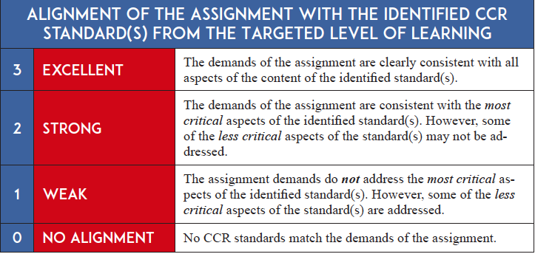
Step 2: Alignment Descriptors
Notes:
Big Idea: Present rating descriptors and make sure that there is a clear understanding of their meaning before proceeding.

Slide 12
Reminders for Step 2
Do not assume skills and knowledge that are not obvious or readily apparent in the assignment, even if all agree that is probably what was meant.
The presenting instructor should listen to team members’ thoughts on the assignment’s alignment with CCR standards before joining the discussion. The workgroup will benefit from having team members, who are new to the assignment, speak first.
10 –15 minutes
Notes:
Big Idea: Identify the CCR standard(s) that best align with the assignment demands as determined in Step 1 as well as the supporting materials (answer keys, rubrics, etc.).
Facilitator Talking Points:
Again, use only evidence available in the assignment. Inferences, assumptions on what might have been intended, etc. are not evidence of CCR alignment.
Be sure to record alignment ratings, and notes and observations in the space provided in the protocol under Step 2.
Facilitator Notes:
After reviewing the process for Step 2, participants will engage in the process shortly thereafter. Participants will now engage in the process (individually and collectively) for Step 2 for 10-15 minutes.
Though it may be difficult, let participants know that the presenting instructor should first listen to group member’s discussion. That way the group can best use the apparent evidence and all can learn from their discussion. Then, the presenting instructor can add to the discussion what standards he or she was attempting to address.
Ask participants to select a maximum of 4 standards that are most central to the goals of the task.
Ask some members to report out to the whole group.

Slide 13
Step 3: Analyze Student Work
Take time to consider each sample of student work individually and make notes in the chart.
Work collectively to compare and reconcile individual reflections and to identify patterns across the work samples.
Notes:
Big Idea: Look at students’ responses to the assignment as a key to improving the assignment.
Facilitator Talking Points:
Starting with Step 3, the presenting instructors can begin to actively participate.
There are two ways that we define “individually” and “collectively” in this work:
We examine the samples on our own to begin with (individually) and then come together to share our thinking (collectively).
We first look at each individual sample of student work and then at the patterns across the collection.
Facilitator Notes:
In Step 3, group members look at the students’ responses to the assignment.
The tips on this slide will help the process go smoothly.
Participants will first work individually to diagnose student work---then work collectively to compare and reconcile.

Slide 14
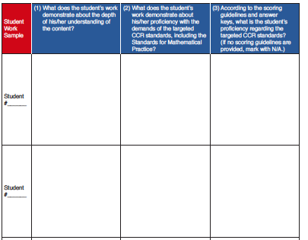
Examining Student Work Samples
1
2
Use the information you wrote in the columns to compare student responses and find patterns across the collection.
Notes:
Big Idea: Student work provides robust evidence of learning – this chart will help record evidence of student work as reviewed by group members.
Facilitator Talking Points:
Click through the animation on the slide and then read and discuss the three Guiding Questions in the table:
What does the student work demonstrate about the depth of his/her understanding of the content?
What does the student work demonstrate about his/her proficiency with the demands of the targeted CCR standards, including the Standards for Mathematical Practices?
According to the scoring guidelines and answer keys, what is the students’ proficiency regarding the targeted CCR standards? (If no scoring guidelines are provided, mark with N/A.)
What does the pattern of student responses demonstrate about the clarity and alignment of the assignment?
Facilitator Notes:
Group members should be given time to consider the samples individually.
Review the process for Step 3, participants will engage in the process in a moment.

Slide 15
Reminders for Step 3
Number the student work samples so that they can be more easily referenced.
Ask the presenting instructor to fully participate in Steps 3 and 4.
20 minutes
Notes:
Big Idea: Provide tips and reminders for participants as they determine patterns in student work.
Facilitator Notes:
Point out the set of Guiding Questions. Explain that they focus us on patterns seen across the collection of student work samples. Such patterns can give us ideas about how to re-envision the lesson.
Review the questions and ask for any needed clarification.
Group members engage at tables in discussion of Step 3 questions for 20 minutes.
Be sure to note observations about the pattern of student work in the space provided in Step 3.
Whole group share-out for 5 minutes on their findings.

Slide 16
Step 4: Redesign and Strengthen the Assignment
Review your notes from Steps 1−3.
Collectively decide how to strengthen the assignment so that it aligns more closely with the CCR standards. Then. . .
Provide time for the presenting instructor to outline the instructional practices that will be used in “new” lessons.
Look beyond the specific assignment to draw conclusions about what the group has learned in the process.
Consider ideas for additional professional development.
Notes:
Big Idea: The group members now use the evidence gathered and discussion to collectively revise the assignment.
Facilitator Notes:
Review the listed bullets to remind participants of the steps and considerations of an assignment revision.
Group needs to decide what to keep, delete, or add to the assignment so that it better aligns with the CCR standards.
One member of the group should fill out the Redesigned Assignment form.

Slide 17
Reminders for Step 4
Use the standards more than the details of the original assignment to guide your redesign.
Add standards if it seems appropriate.
Decide what to keep, delete, and/or add to the assignment based on all the data collected to:
Better align the assignment with the CCR standards.
Promote active problem-solving, exploration, or critical thinking.
Address student errors and misconceptions.
15 - 20 minutes
Notes:
Big Idea: Provide some tips for successful application of Step 4. Based on the original assignment CCR-alignment rating, what can be done to strengthen the assignment?
Facilitator Talking Points:
The review of the assignment and student work now are considered together to make changes to the assignment.
If the assignment is weakly aligned with the identified CCR standards (score of 1), then how can the assignment be strengthened? Use the content of the selected standards more than the specifics of the original assignment to guide the redesign.
If only one standard aligns with the original assignment, which standards could be added to enrich the assignment?
If the assignment is already well aligned, but students did not perform well, what are some supportive instructional approaches that could help students reach the proficient level of performance the team identified for the assignment? (Consider how to reconfigure the assignment to address common errors and misconceptions.)
Redesign based on evidence gathered with a focus on the CCR standards.
Be sure to note changes in the protocol section under Step 4.

Slide 18
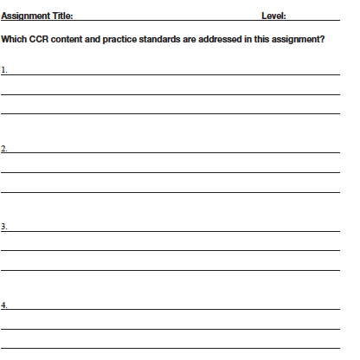
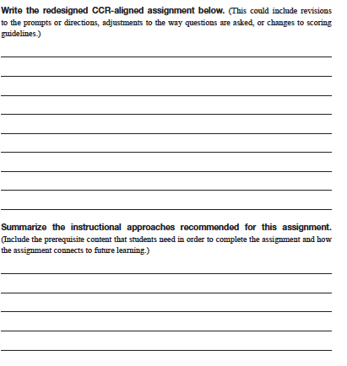
Redesign Assignment #1
List targeted standards here.
Make suggestions to improve alignment here.
Summarize recommended instructional approaches here.
Notes:
Big Idea: Formalize the assignment’s improvements so that they can be used by other group members and teachers.
Facilitator Notes:
Have participants bring out the form they see on the screen.
Then have them take about 10 minutes to write suggestions for improving the CCR-aligned assignment on the form. (This could include revisions to the prompts or directions, adjustments to the way questions are asked, or changes to scoring guidelines.)
Summarize the instructional approaches recommended for this assignment, including the prerequisite content that students need in order to complete the assignment and how the assignment connects to future learning.
Then take another 10 minutes or so to ask each table to report one or two highlights of their discussion to the group.

Slide 19
Strengthen the Lesson
Scan the lesson noting its purpose, content, and organization.
Decide collectively how to strengthen the lesson:
What does the student work tell us about the kind of work, level of knowledge and skills students have learned and still need to learn?
How can we reconfigure the lesson to address common errors and misconceptions noted in the student work?
What are the implications of these findings regarding the need for additional instruction?
Do we want to conduct a Lesson Study to share, test, and hone a lesson to accompany the (improved) assignment?
Notes:
Big Idea: Decide if the lesson needs to be strengthened.
Facilitator Note:
If the student work indicates errors and misunderstanding significant enough to require re-teaching, instructors can choose to conduct a follow-up Lesson Study to hone the lesson.

Slide 20
Additional Practice
Use the protocol with another assignment and collection of student work samples. . .
Notes:
Big Idea: Introduce the second sample assignment. Participants will now engage in the Student Work Protocol in their table groups.
Facilitator Notes:
Give participants time to find the materials for the sample assignment #2.
Remind participants that they should not look at student work or supporting materials until after their first encounter with the task.
Participants should take the assignment at face value and only give purpose or demands that the materials provide evidence for.
For the last 5 minutes bring the group together to share their thinking on the task.

Slide 21
Review the Four Steps of the Student Work Protocol
Analyze the purpose and demands of Assignment #2.
Select the CCR standards that best match the assignment’s demands.
Analyze student work.
Redesign and strengthen the assignment and the accompanying instructional approaches.
1.5 hours
Notes:
Big Idea: Remind participants of the steps of the protocol.
Facilitator Notes:
Participants will have about 1.5 hours to engage in all 4 steps of the protocol.
Analyze the purpose and demands of the assignment (without consulting the student work or standards): What are students expected to learn from the assignment? What skills and knowledge must students exhibit to complete the assignment successfully?
Select CCR standards that best fit the demands of the assignment: How closely aligned is the assignment with one or more level-specific CCR content standards? Is one or more of the Key Advances evident in the assignment?
Analyze student work: What does the student work reveal about the skills and knowledge students have learned and still need to learn?
Redesign and strengthen the assignment: What does the student work suggest about how the assignment, or the supporting instruction, might be re-envisioned? How can the assignment be enhanced to add greater rigor and encourage higher student achievement?

Slide 22
Redesign Assignment #2
List targeted standards here.
Make suggestions to improve alignment here.
Summarize recommended instructional approaches here.
Notes:
Big Idea: Formalize the assignment’s improvements so that they can be used by other group members and teachers.
Facilitator Talking Points:
Write suggestions for improving the CCR-aligned assignment. (This could include revisions to the prompts or directions, adjustments to the way questions are asked, or changes to scoring guidelines.)
Summarize the instructional approaches recommended for this assignment, including the prerequisite content that students need in order to complete the assignment and how the assignment connects to future learning.
Facilitator Note:
Ask a couple of participants to report out.

Slide 23
Group Sharing
Ask participants to share their redesigned assignments with the whole group.
1 hour
Notes:
Big Idea: In what ways did you redesign the assignment? How did the standards, assignment materials, and student work guide your group’s redesign?
Facilitator Notes:
Have a couple of tables share their overall changes and insights, with remaining tables contributing if they have more to add or if they have different opinions or perspectives. Work toward some agreement as to the actual alignment of the assignment.
How might this protocol support educators in engaging in evaluating alignment of assignments to the CCR standards and in sustaining CCR standards implementation?
Ask some members from each table group to report out to the whole group about whether they think the lesson needs to be strengthened.

Slide 24
Feedback Checklist for Team Members
I will… I did...
Provide feedback on the strengths and accomplishments of the assignment, as well as on its weaknesses and on areas where it can be strengthened.
Give feedback in a manner I would like to receive it.
Focus on the assignment, rather than on judgments about my colleague as a person or a professional.
Demonstrate support for my colleague when providing feedback by using nonjudgmental language and a supportive tone of voice and body language.
Avoid overwhelming my colleague with more feedback than is needed. Encourage my colleague to let me know when it is difficult to hear my feedback.
Be as specific as possible, suggesting instructional approaches, resources, etc., to improve the assignment.
Leave my colleague feeling helped, motivated, and inspired.
Notes:
Big Idea: Each member reflects on his or her own feedback and collaboration.
Facilitator Notes:
Spend some time reviewing and reflecting on what constitutes effective, respectful feedback for fruitful discussions. Start by reviewing the feedback checklist.
For at least the first few meetings, ask each team member—including the presenting instructor—to fill out the feedback checklist before and after the sessions. This will firmly establish the ground rules with team members and serve as a reminder to self-assess the quality of their feedback.
As the team gains experience, they may want to use the checklist intermittently, as a refresher.
Have participants review and discuss their alignment today to this feedback checklist.

Slide 25
Guidelines for Implementing the Student Work Protocol in Adult Education Programs
Guidelines focus on:
Scheduling workgroups
Facilitating workgroups
Preparing materials for workgroups
Cataloguing improved assignments

Slide 26
Determine the Full Schedule of Workgroups to Allow Staff to Plan
Every team member should have the opportunity to submit at least one of his or her assignments for review.
The more regularly workgroups hold meetings, the more automatic and efficient the process will be.
Notes:
Big Idea: Plan ahead by scheduling several meetings.

Slide 27
Plan to Facilitate First Several Meetings of Each Workgroup
Facilitators should:
Remind reviewers to keep comments on topic.
Give supportive feedback.
Watch the time to keep the process moving.
Notes:
Big Idea: Facilitating the first several meetings of a workgroup will ensure the process runs smoothly.

Slide 28
Prepare for Workgroup Meetings
Choose a confident instructor who is open to receiving feedback from peers—someone who can model the process—to present the first assignment.
Collect the assignment, corresponding student work, and lesson plan for copying and sharing with the team.
If possible, provide team members with a copy of the assignment prior to meeting.
Notes:
Big Idea: Make preparations prior to the workgroup meeting.

Slide 29
Catalogue the Improved Assignment
Ask the presenting instructor to implement the redesigned assignment with a class of students.
Then, during the next meeting of your workgroup:
Summarize how the assignment was strengthened. Note ways it might be improved further.
Explain briefly any teaching strategies you used to better prepare students for the assignment.
Share examples of new student work and describe what they indicate about improved student learning and achievement.
If the assignment proves successful, add the improved assignment to a resource file for instructors in your program to use.
Notes:
Big Idea: Review next steps in the process for implementing the improved assignment.
Facilitator Note:
Review the steps with participants that they will use in their programs.

Slide 30
Final Discussion
Questions and Comments

